Slide 1

CDA project
Alokesh Manna

Slide 2
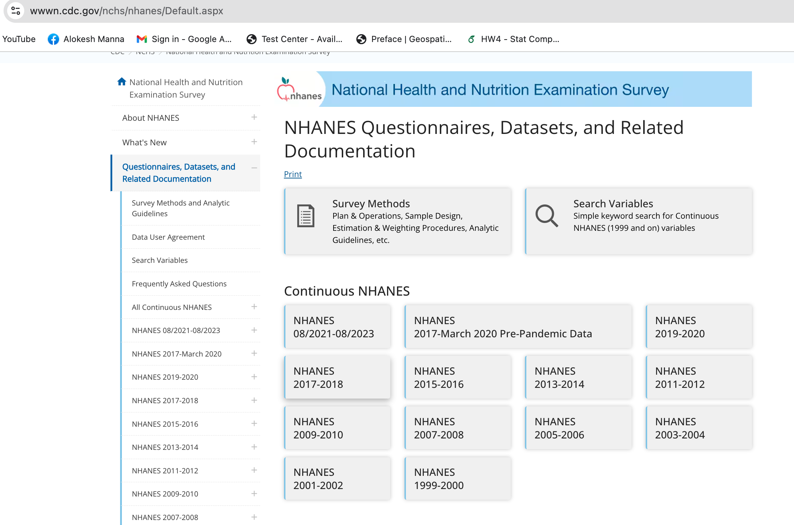
Data
National Health and Nutrition Examination Survey, NHANES
We consider the most recent data 08/2021-08/2023

Slide 3
Questions
Is there an association between race (specifically black and white) and immigration status (within the black population) with the development of chronic diseases in the USA? The chronic diseases of interest include cholesterol levels (BPQ080), blood pressure (BPQ020), and diabetes (from a separate dataset, DIQ010). For this analysis, we will focus on blood pressure.
Non-Hispanic population black (1) and white (2), BP yes (1) and no (2),
college education yes(1) and no (0), Gender male (1) and female (2) are 5 categorical variables that we consider for this analysis.
We also add another variable DMDYRSUR which is how many years they are living in the US is a continuous variable.
Another important consideration is that there are a lot of missing data. When we joined the data frames, the initial size is approximately 8501 which came down to 1574 for the overall population without any missing data and 347 for only the NH population.

Slide 4
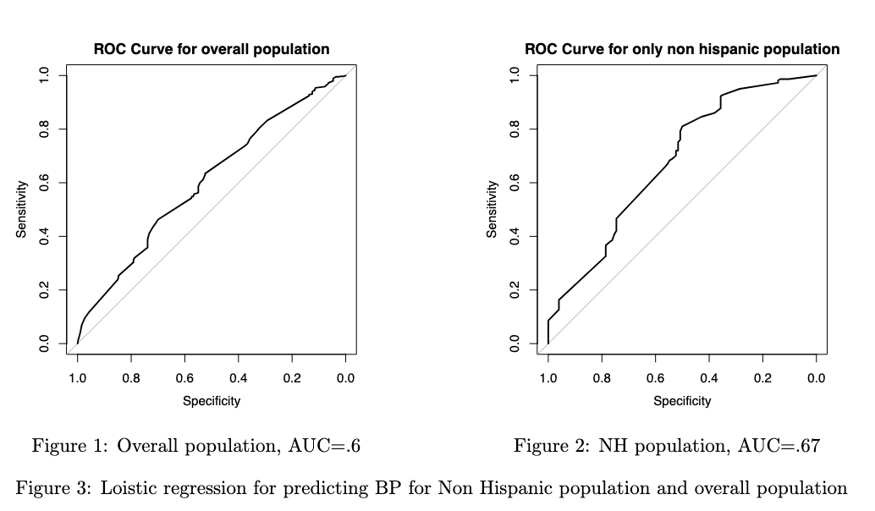
Conclusions
The prediction is better when we consider only the non-Hispanic population. It can be verified by AUC.
If we just compare the marginal without considering any covariate information, the p-value is not significant, and the gamma coefficient is 0 as we did not have sufficient evidence to reject the null (no association between bp and gender).
In the other case when we consider a subpopulation and concentrate only on the non-Hispanic population, the p-value of the test of odds-ratio is < .03 and γ > 1 which indicates the association of the BP and gender.

Slide 5
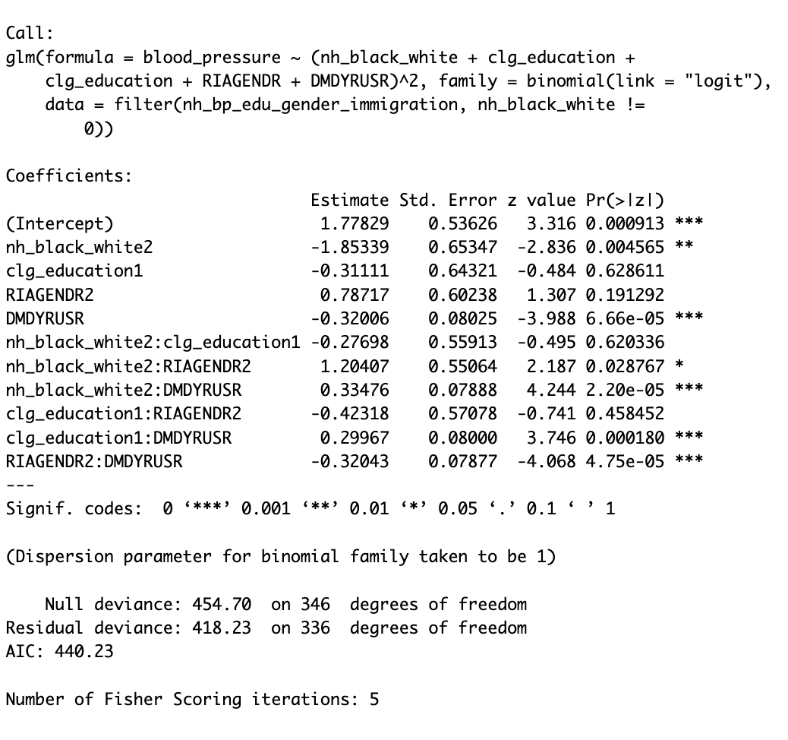
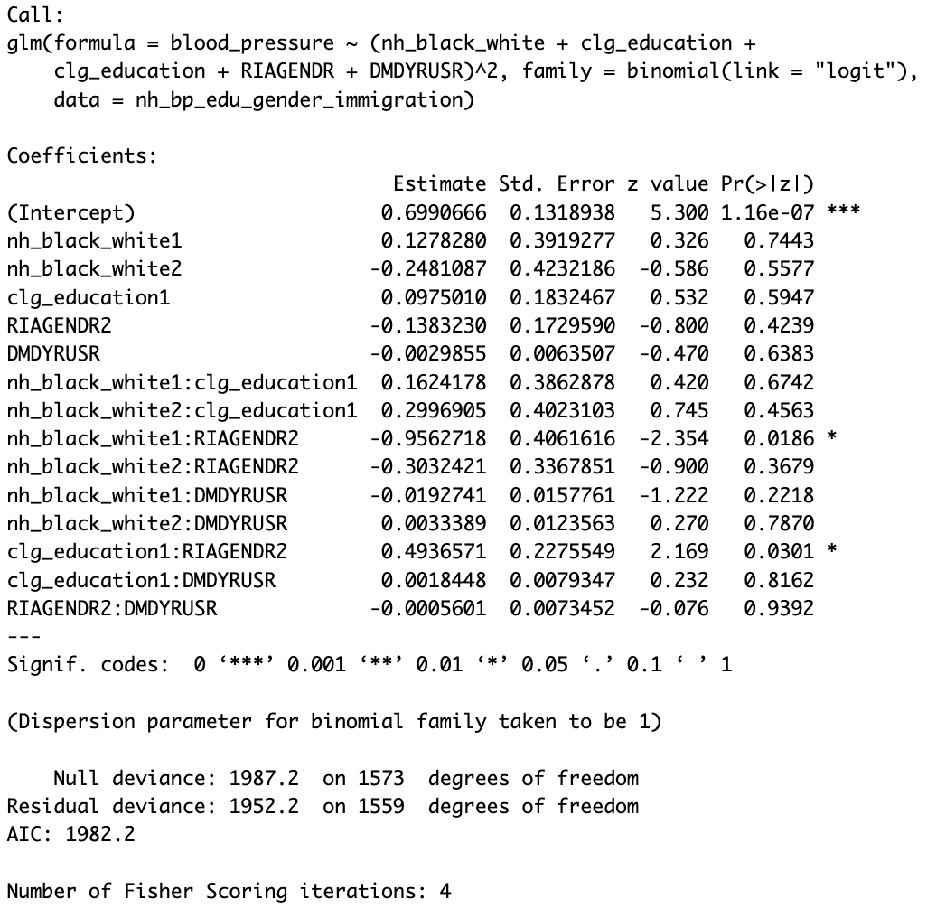
Left: Only NH population, Right: Overall population, Not including the age variable

Slide 6
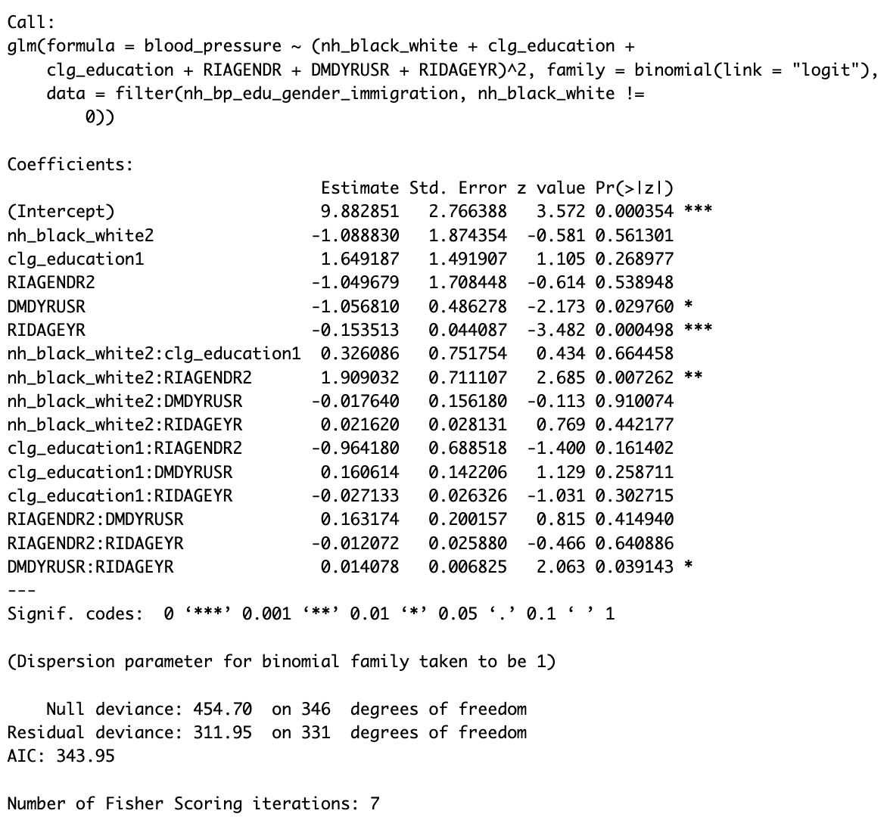
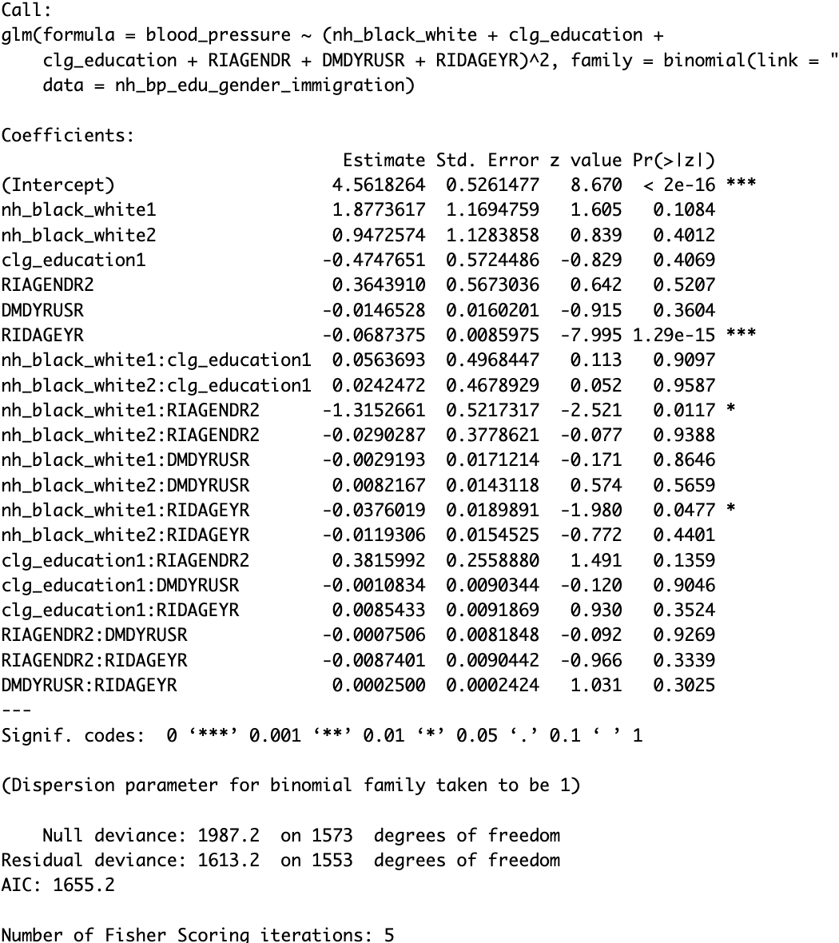
Left: Only NH population, Right: Overall population, after including the age variable

Slide 7
Important takeaways
When we added another variable, say age (RIAGEYR), we saw that this variable was significant in both cases, i.e., the overall population and only the non-Hispanic population. The AUC became .85 for the Nh population and .78 for the overall population. So, it was important to add the age variables!
The odds ratio and gamma coefficients do compare the marginal association. Although we did not get any association in the overall population, when we included different important covariates the race variable (nh_black_white) came to be significant as an interaction with other covariates!
Odds Ratios Ignore Covariate Adjustments. Odds ratios are often interpreted in isolation without accounting for the influence of confounding variables.
Odds ratios from basic comparisons (e.g., 2x2 tables) do not account for interaction terms between variables.
Odds ratios are typically used in categorical contexts but cannot handle continuous variables without discretization, which leads to loss of information.

Slide 8
Important takeaways…
Odds ratios do not offer information about the model fit, such as residuals, goodness-of-fit tests, or diagnostics for multicollinearity or influential points.
Regression analysis provides a more robust framework for:
Adjusting for confounding variables.
Exploring interactions.
Working with continuous predictors.
Assessing model fit and statistical significance.

Slide 9
Other explorations
The association between blood pressure and meal preparation was significant. The odds ratio CI is (1.202927,1.458402) and the gamma coefficient is (.09,.18) with a small p-value. self-meal preparation if not, in that case, the blood pressure is higher.
When we added the self-meal preparation index with the existing regression framework, clgeducation1(yes): selfmealprepare2(1 yes, 2 no) came to be significant. If you are busy, probably you need to eat outside resulting in higher blood pressure for NH population.
For the overall population, nh_black_white2:self_meal_prepare2 and DMDYRUSR:self_meal_prepare2 are significant variables. Within the white NH population, there is a tendency of higher BP who do not prepare their food. Immigration and non-self-meal preparation can also indicate higher BP.
When we added marital status, we obtained that ”Never married (DMDMARTZ3 >0)” people had a higher tendency to have BP. And another interaction term “RIDAGEYR: DMDMARTZ3 (<0)” became significant.

Slide 10
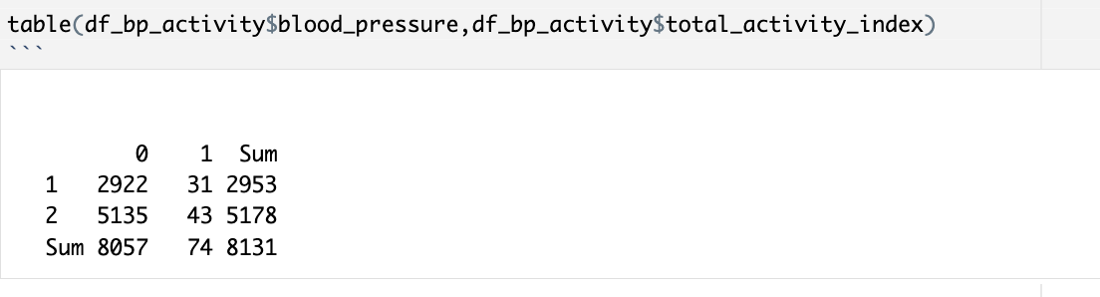
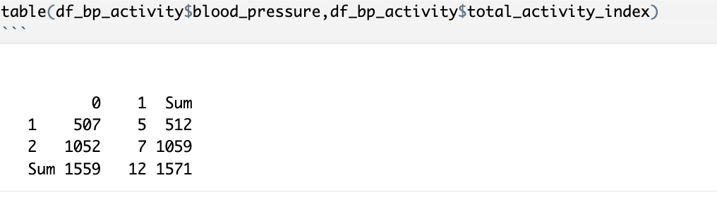
Physical activity?
We did not obtain physical activity in relationship with the BP. One reason might be we have a very low number of people who are doing physical activity in the data.

Slide 11
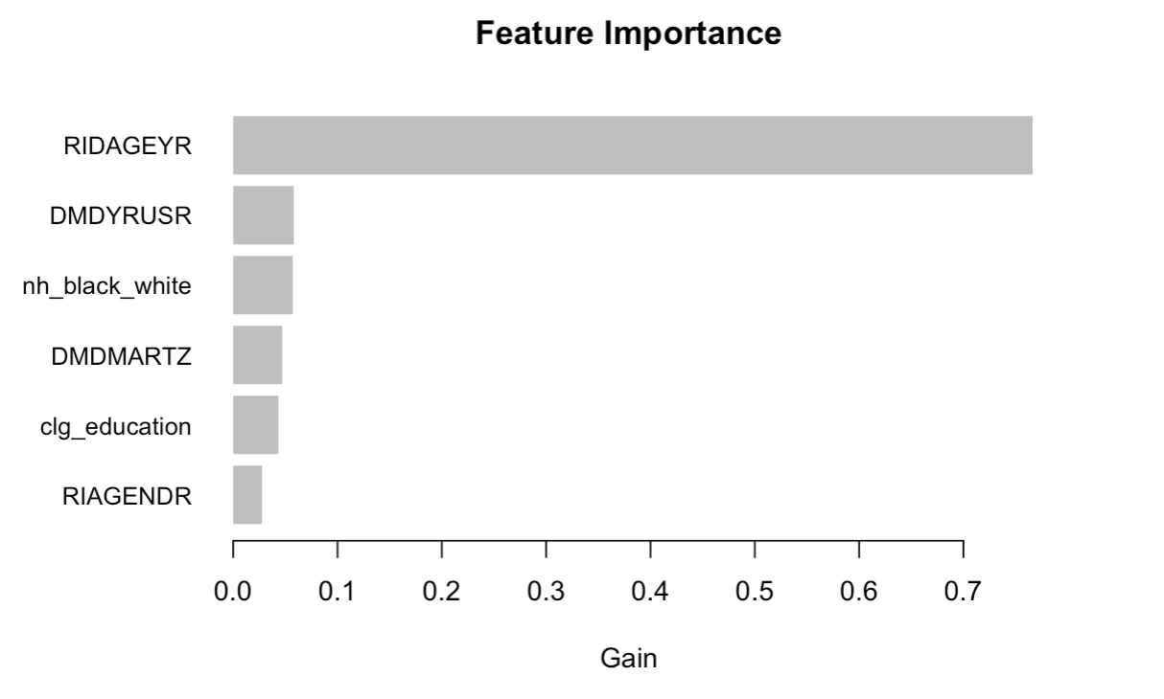
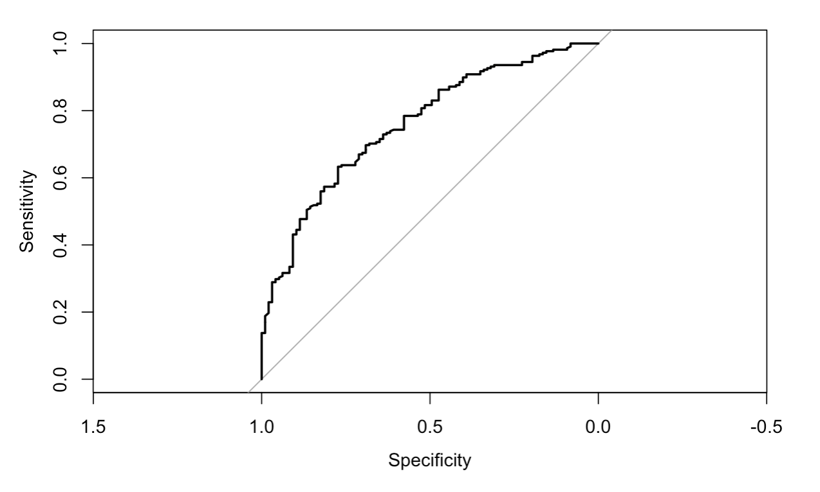
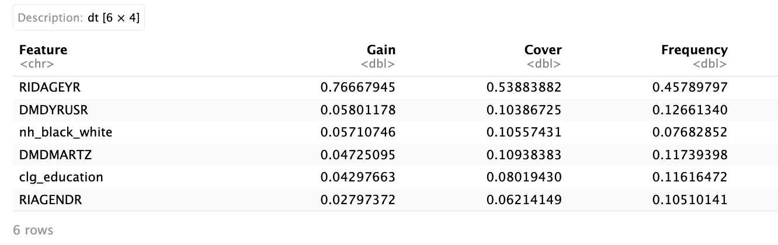
ML techniques: lightGBM (A decision tree based method), accuracy: .74, AUC: .76

Slide 12
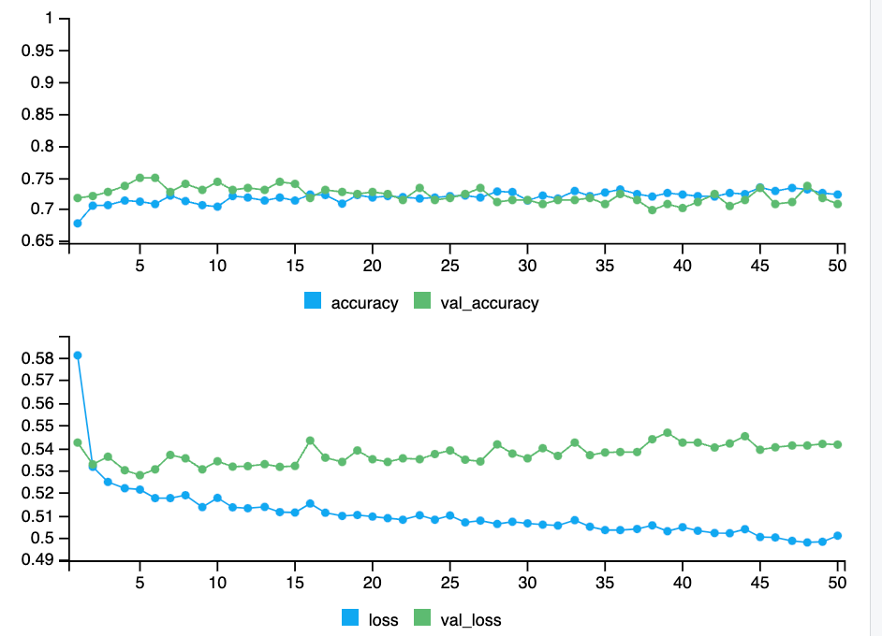
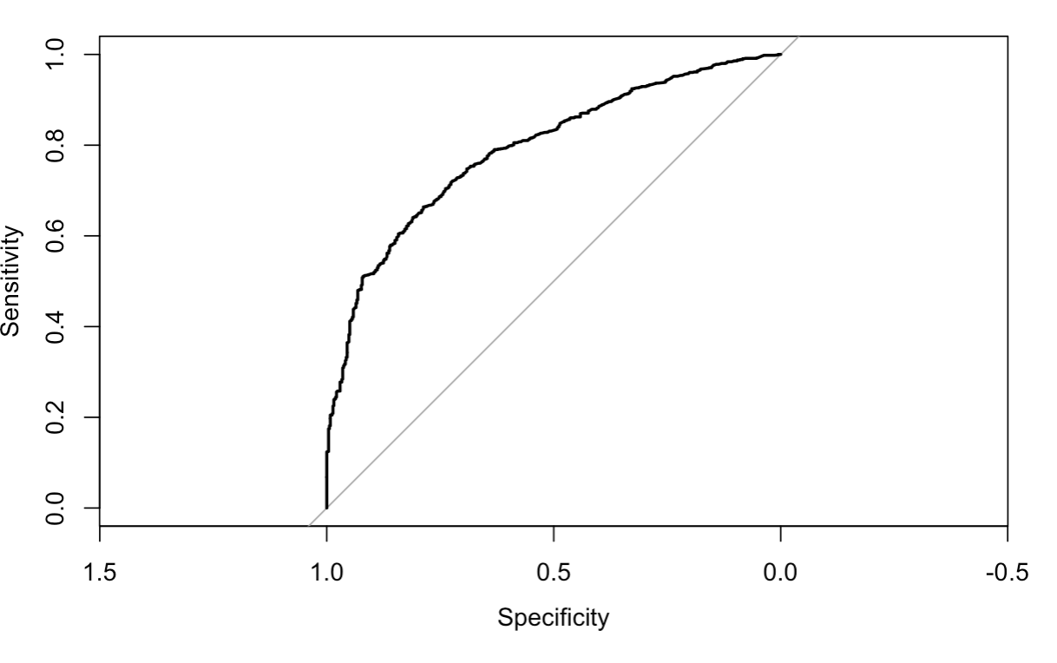
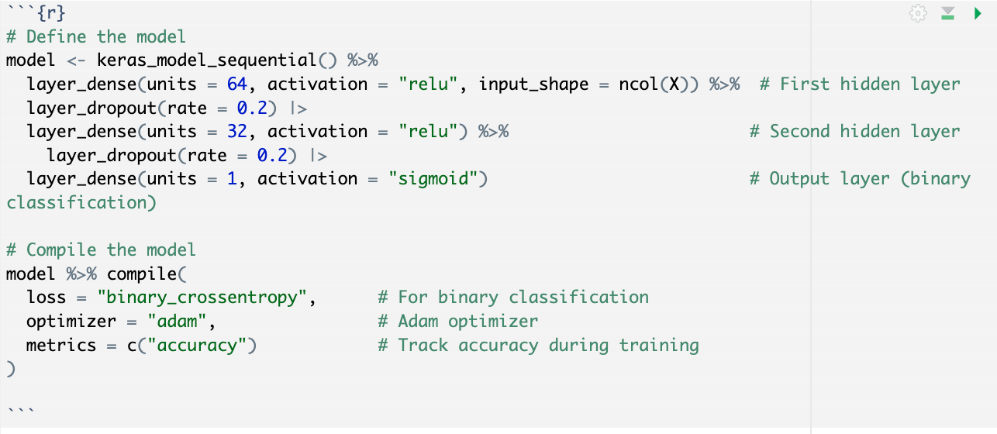
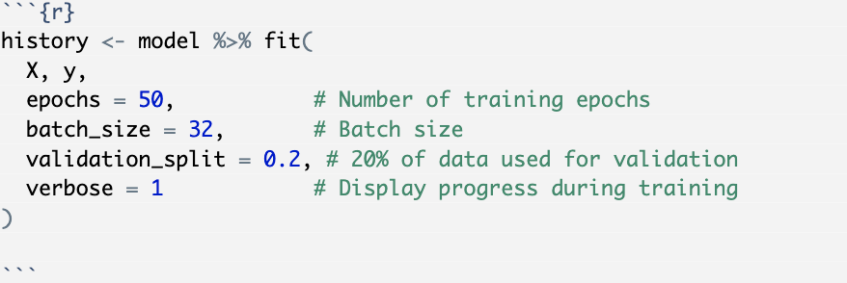
NN; "Accuracy: 0.728198599618078”, AUC: .79

